Slide 1

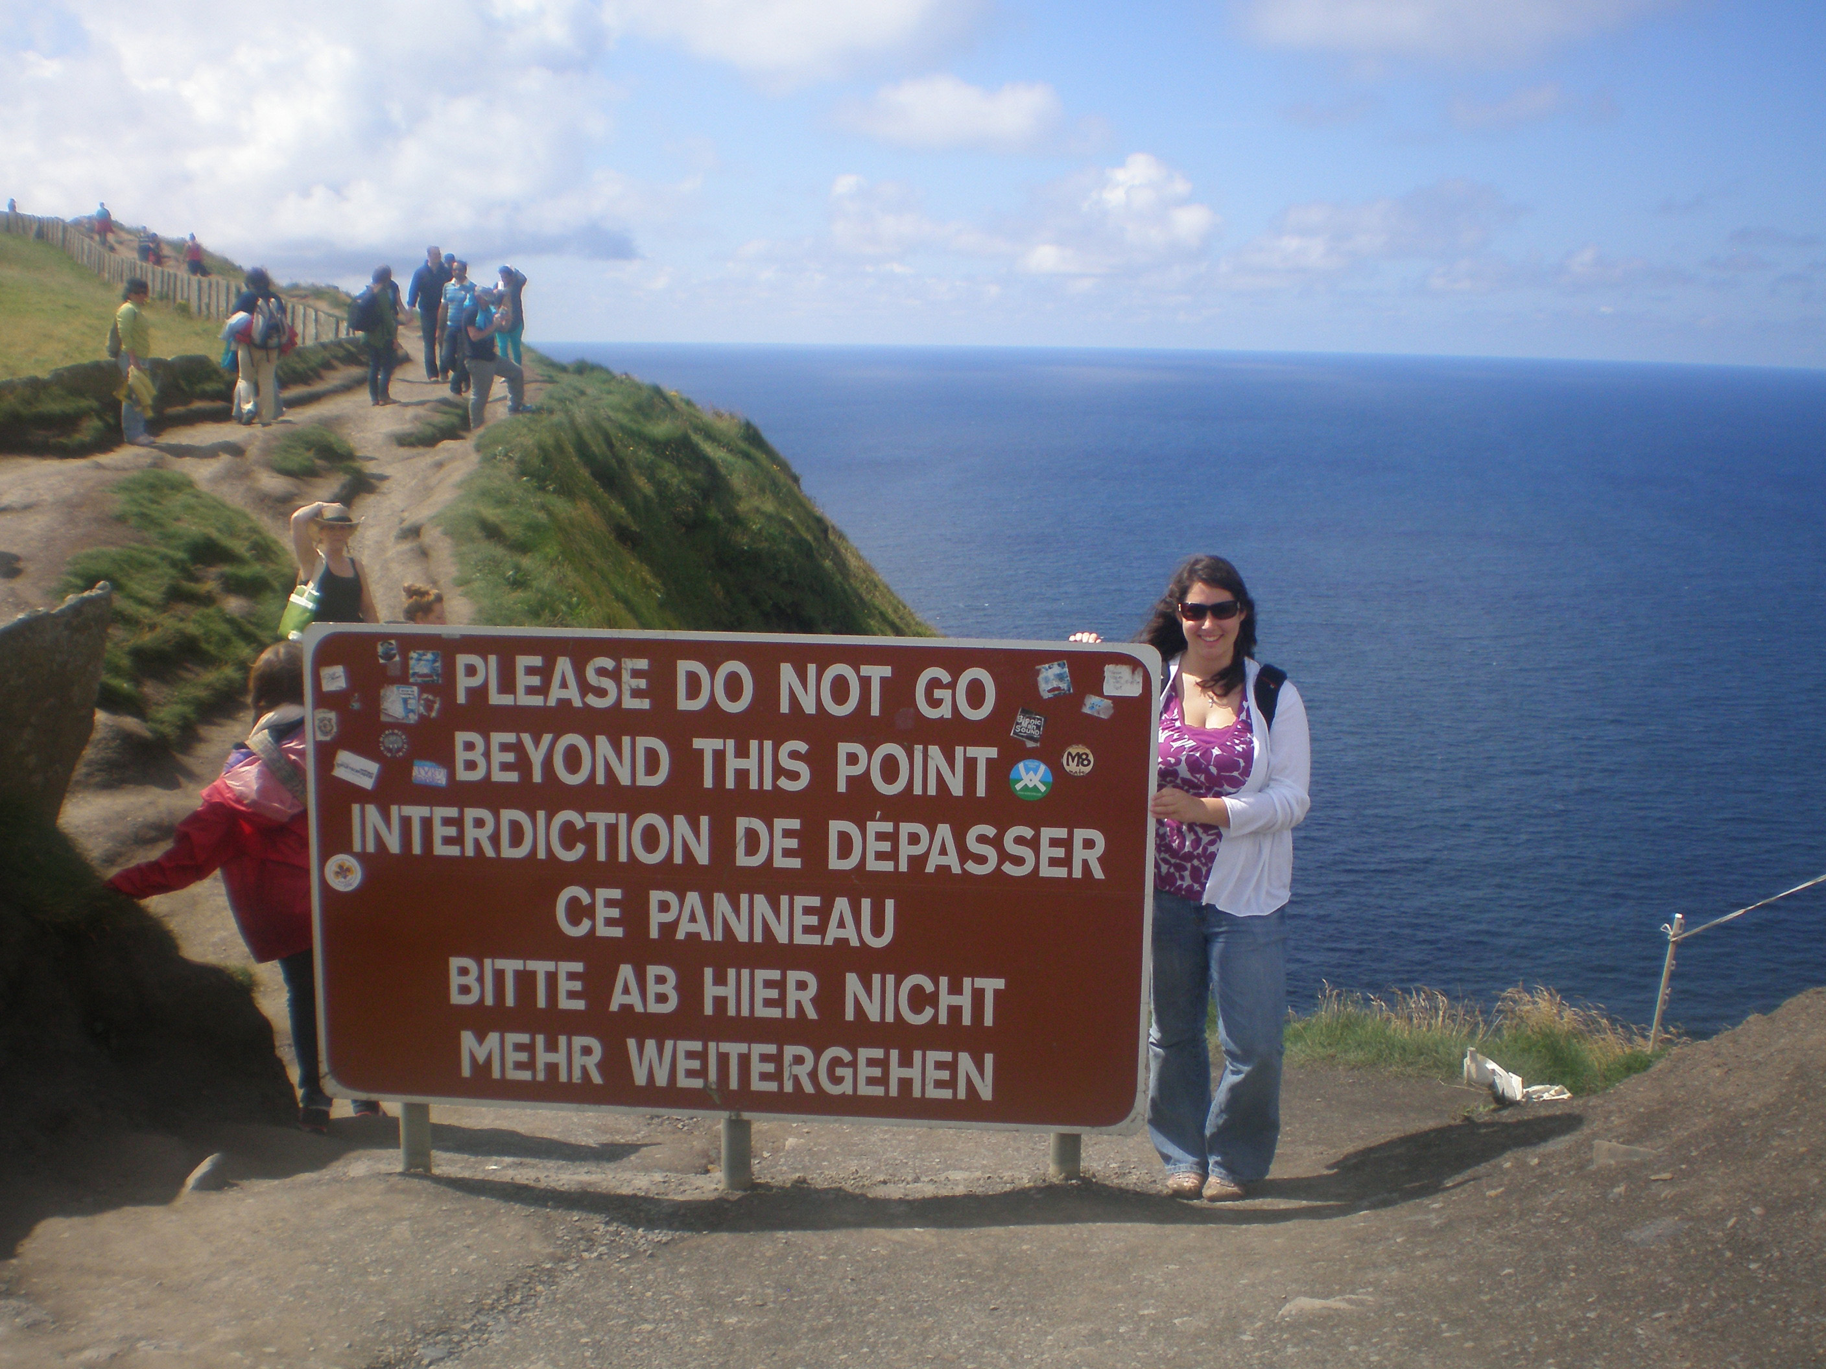
Emergency Preparedness and Response
For Program Leaders and Assistants
Ben Chamberlain
International Health & Safety Analyst
Ireland
Updated April 2014

Slide 2
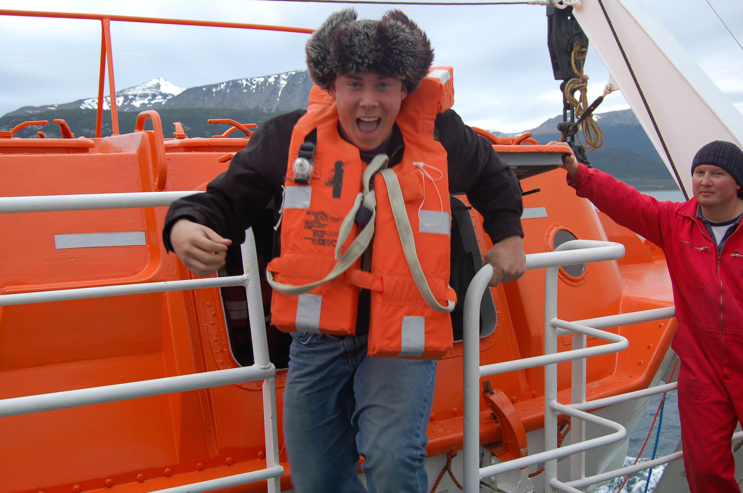
Goals of this seminar
PREVENT …foreseeable harm
PREPARE …for health, safety and security situations by providing information, tools, and resources
RESPOND …to needs of parents, students, faculty & staff
Reduce anxiety associated with travel
Acknowledge participants control over safety and well-being
Facilitate support for leaders and students in difficult situations
Antarctica

Slide 3
Resources For Program Leaders
University Policies:
Workers' compensation: Provides "Workers' Compensation benefits" if an employee is injured in the course of employment.
Indemnification: When acting in the performance of assigned duties on behalf of the University. This policy also applies to students while engaged in approved academic programs and volunteers who are performing services for the University with prior written approval of the appropriate University official.
Anti-Discrimination Policy: Unlawful to discriminate or harass on the basis of age, color, gender, gender identity 5 , disability status, height, marital status, national origin, political persuasion, race, religion, sexual orientation, veteran status, or weight;
Policy on Sexual Harassment: Unwelcome sexual advances, unwelcome requests for sexual favors, or other unwelcome behavior of a sexual nature
(We can facilitate communication with University’s Title IX Coordinator)
Online Materials:
MSU Faculty Handbook
OSA Faculty and Advisers Guide
Department of State Websites
Print Materials:
PLOOM & other materials
Emergency Cards

Slide 4
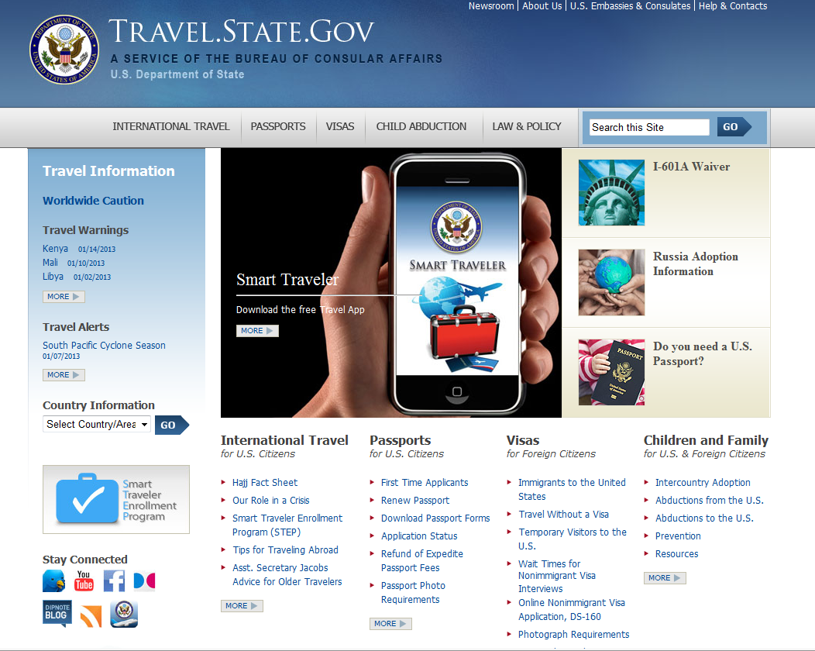
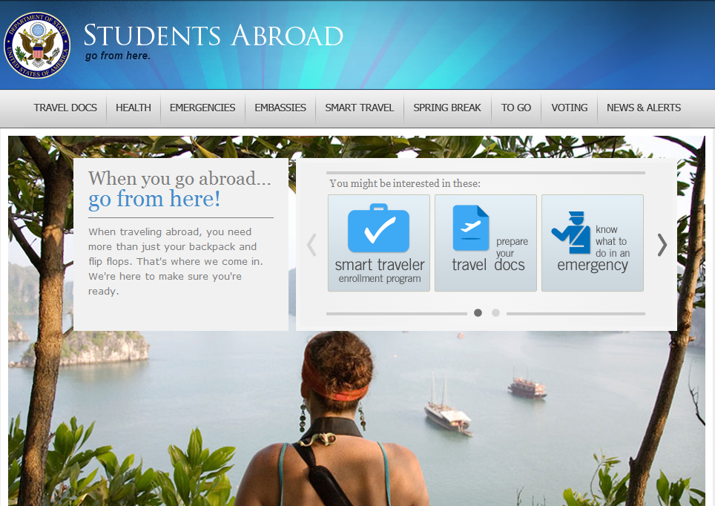
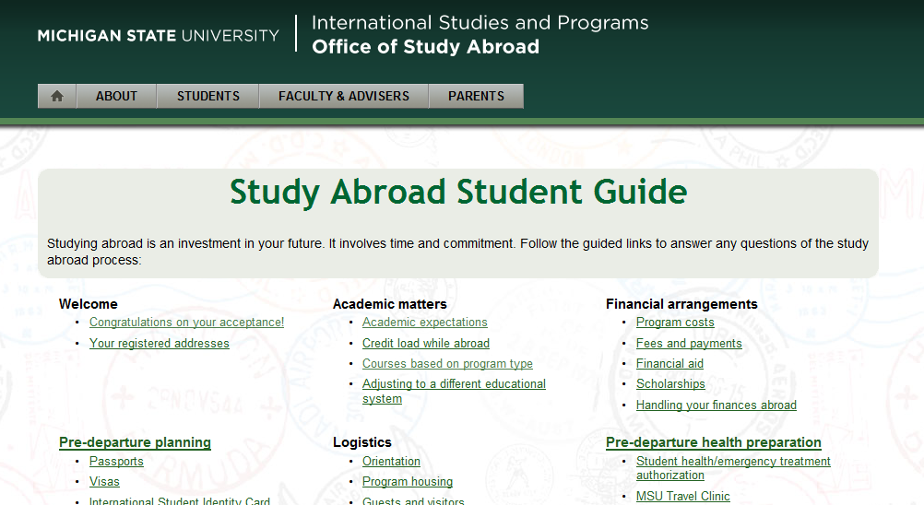
Resources For Participants
University Policies:
Statement of Responsibility
Anti-Discrimination Policy
Policy on Sexual Harassment
Online:
Department of State
Pre-Departure Orientation
Student Guide
Office of Study Abroad
Resource Center / Coordinators
Emergency Cards

Slide 5

MSU Police Dept. 24/7 International Assistance
This number is answered by a cadet at the Department of Police & Public Safety
DPPS will triage the call and contact the most appropriate individual to return the call
001*-517-353-3784
*http://www.howtocallabroad.com
Notes:
You know this stuff….

Slide 6
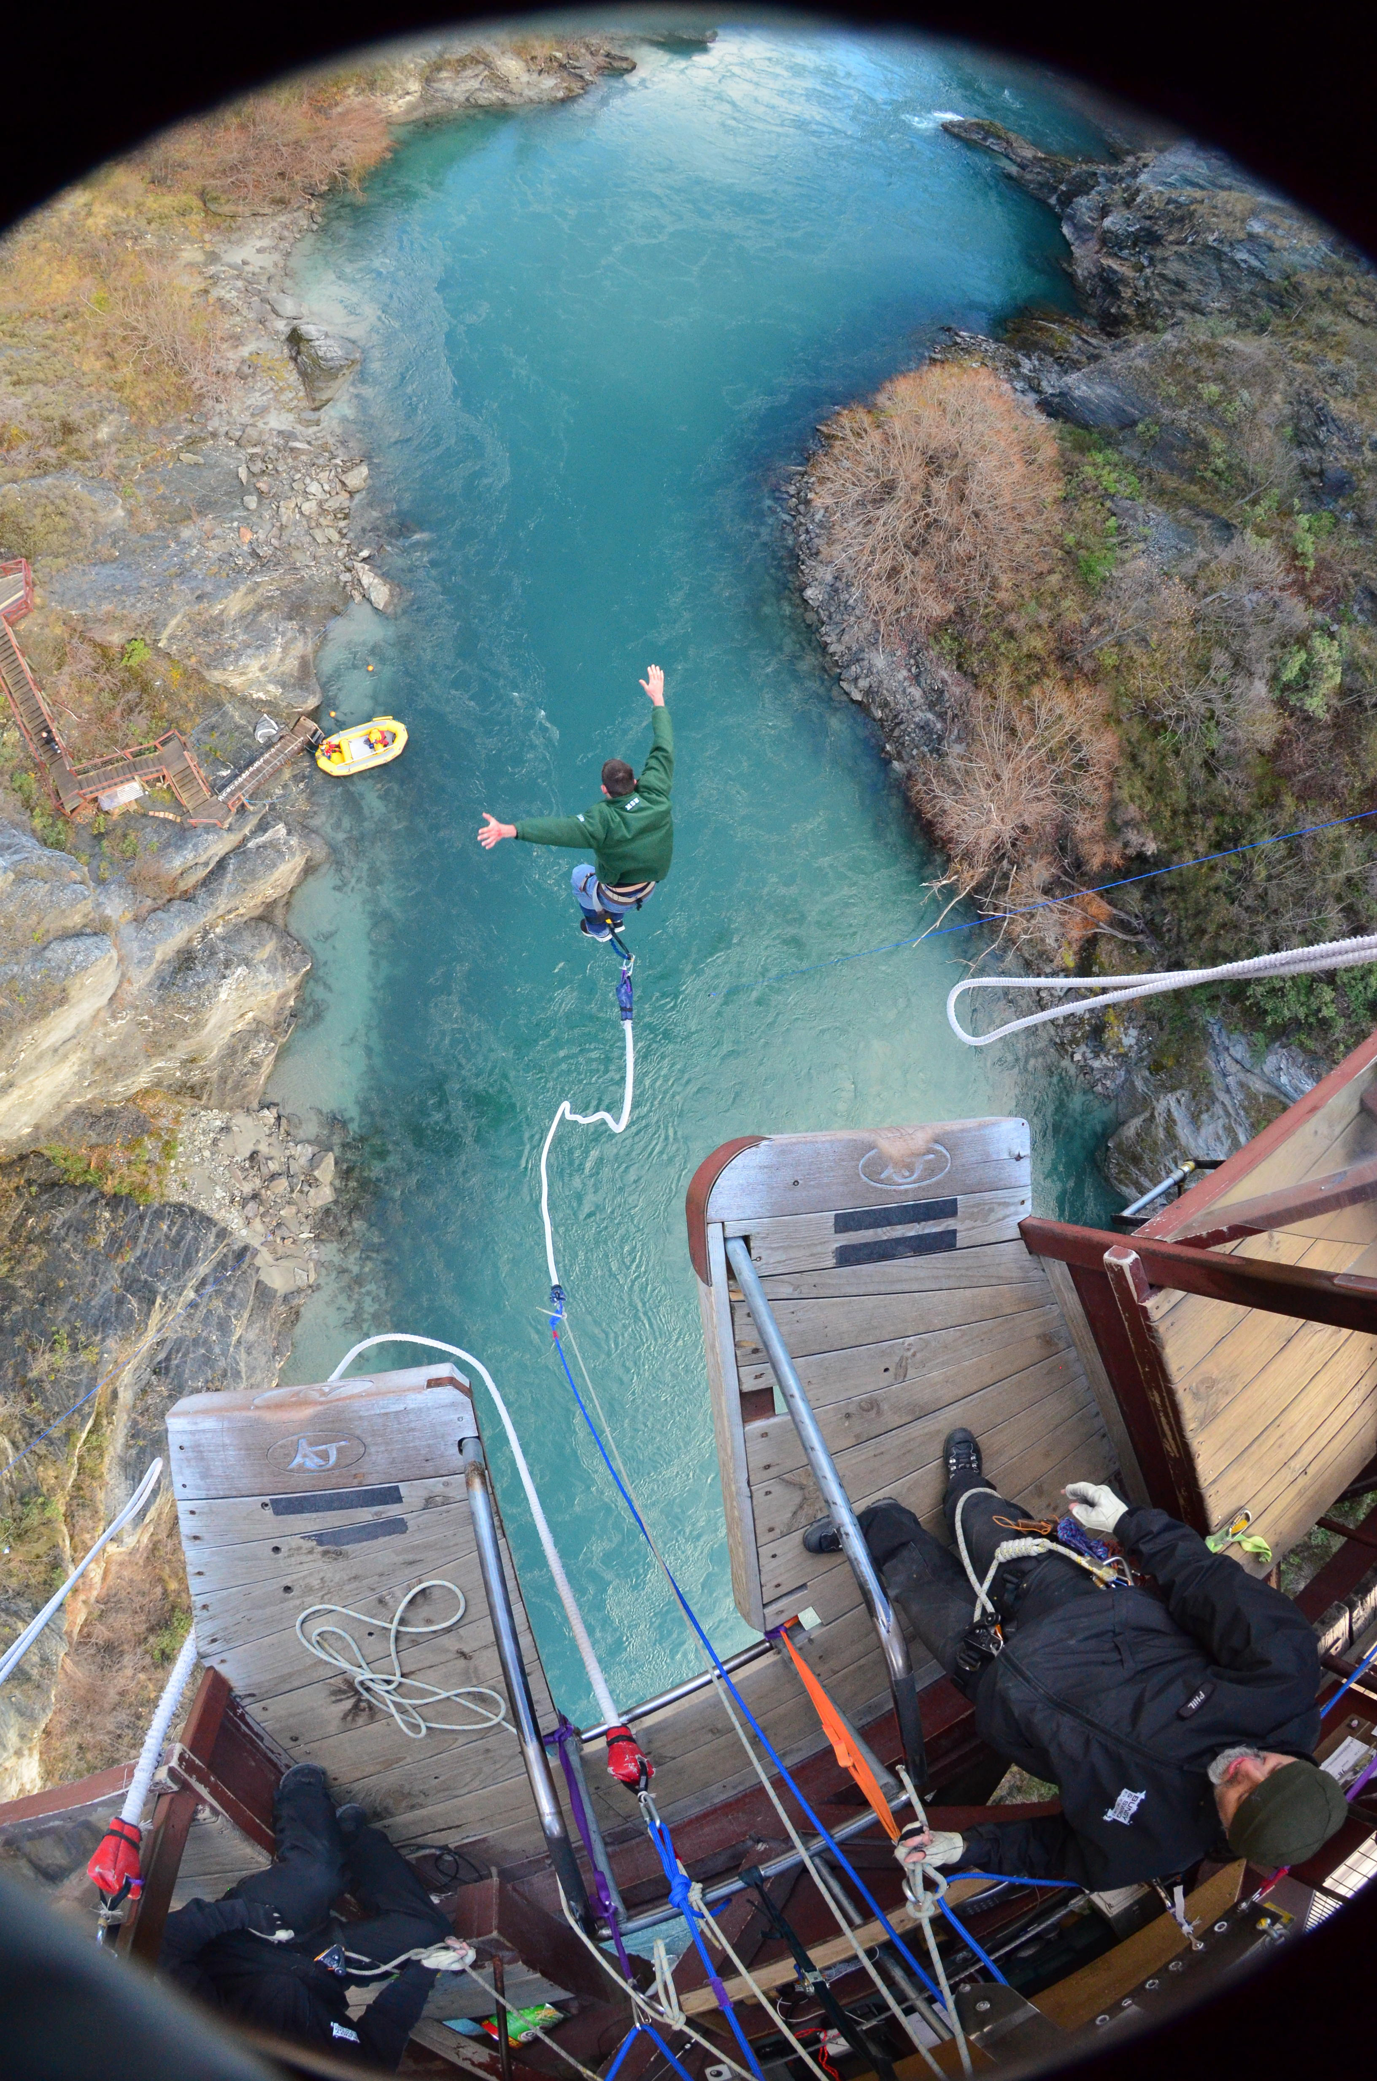
HTH Worldwide Health Policy
100% reimbursement, medical evacuation, bedside visits, and evacuation home with a medical escort
Coverage includes mental health, medical, certain dental, translations, and location of partner facilities
Can direct-pay for planned appointments and care in partner facilities – Call ahead!
24/7 Assistance Line +1-610-254-8771
Note three exclusions: bungee jumping, parachuting and hang gliding
MSU Student Photo Contest
New Zealand
NO!

Slide 7

HTH Worldwide Natural Disaster and Civil Unrest
  Evacuation services
  Account for all students, staff and faculty on site
  Follow local emergency protocols
    Shelter in place
    Have alternative communication plan
  Call MSU 24/7 Line +517-353-3784
  HTH works with MSU-OSA to authorize evacuation and determine an extraction plan
  MSU-OSA will manage the message
MSU student in Turkey

Slide 8

Activities Prior to Departure
  Provide OSA with student and leader contact information in a timely fashion
  Enforce expectation to participate in OSA’s on-line orientation
  Verify HTH insurance
  Offer face to face orientations
  Enroll in STEP – Smart Travelers Enrollment Program
  Monitor news and embassy notices
  Seek Travel Clinic advice
MSU student in Greece

Slide 9
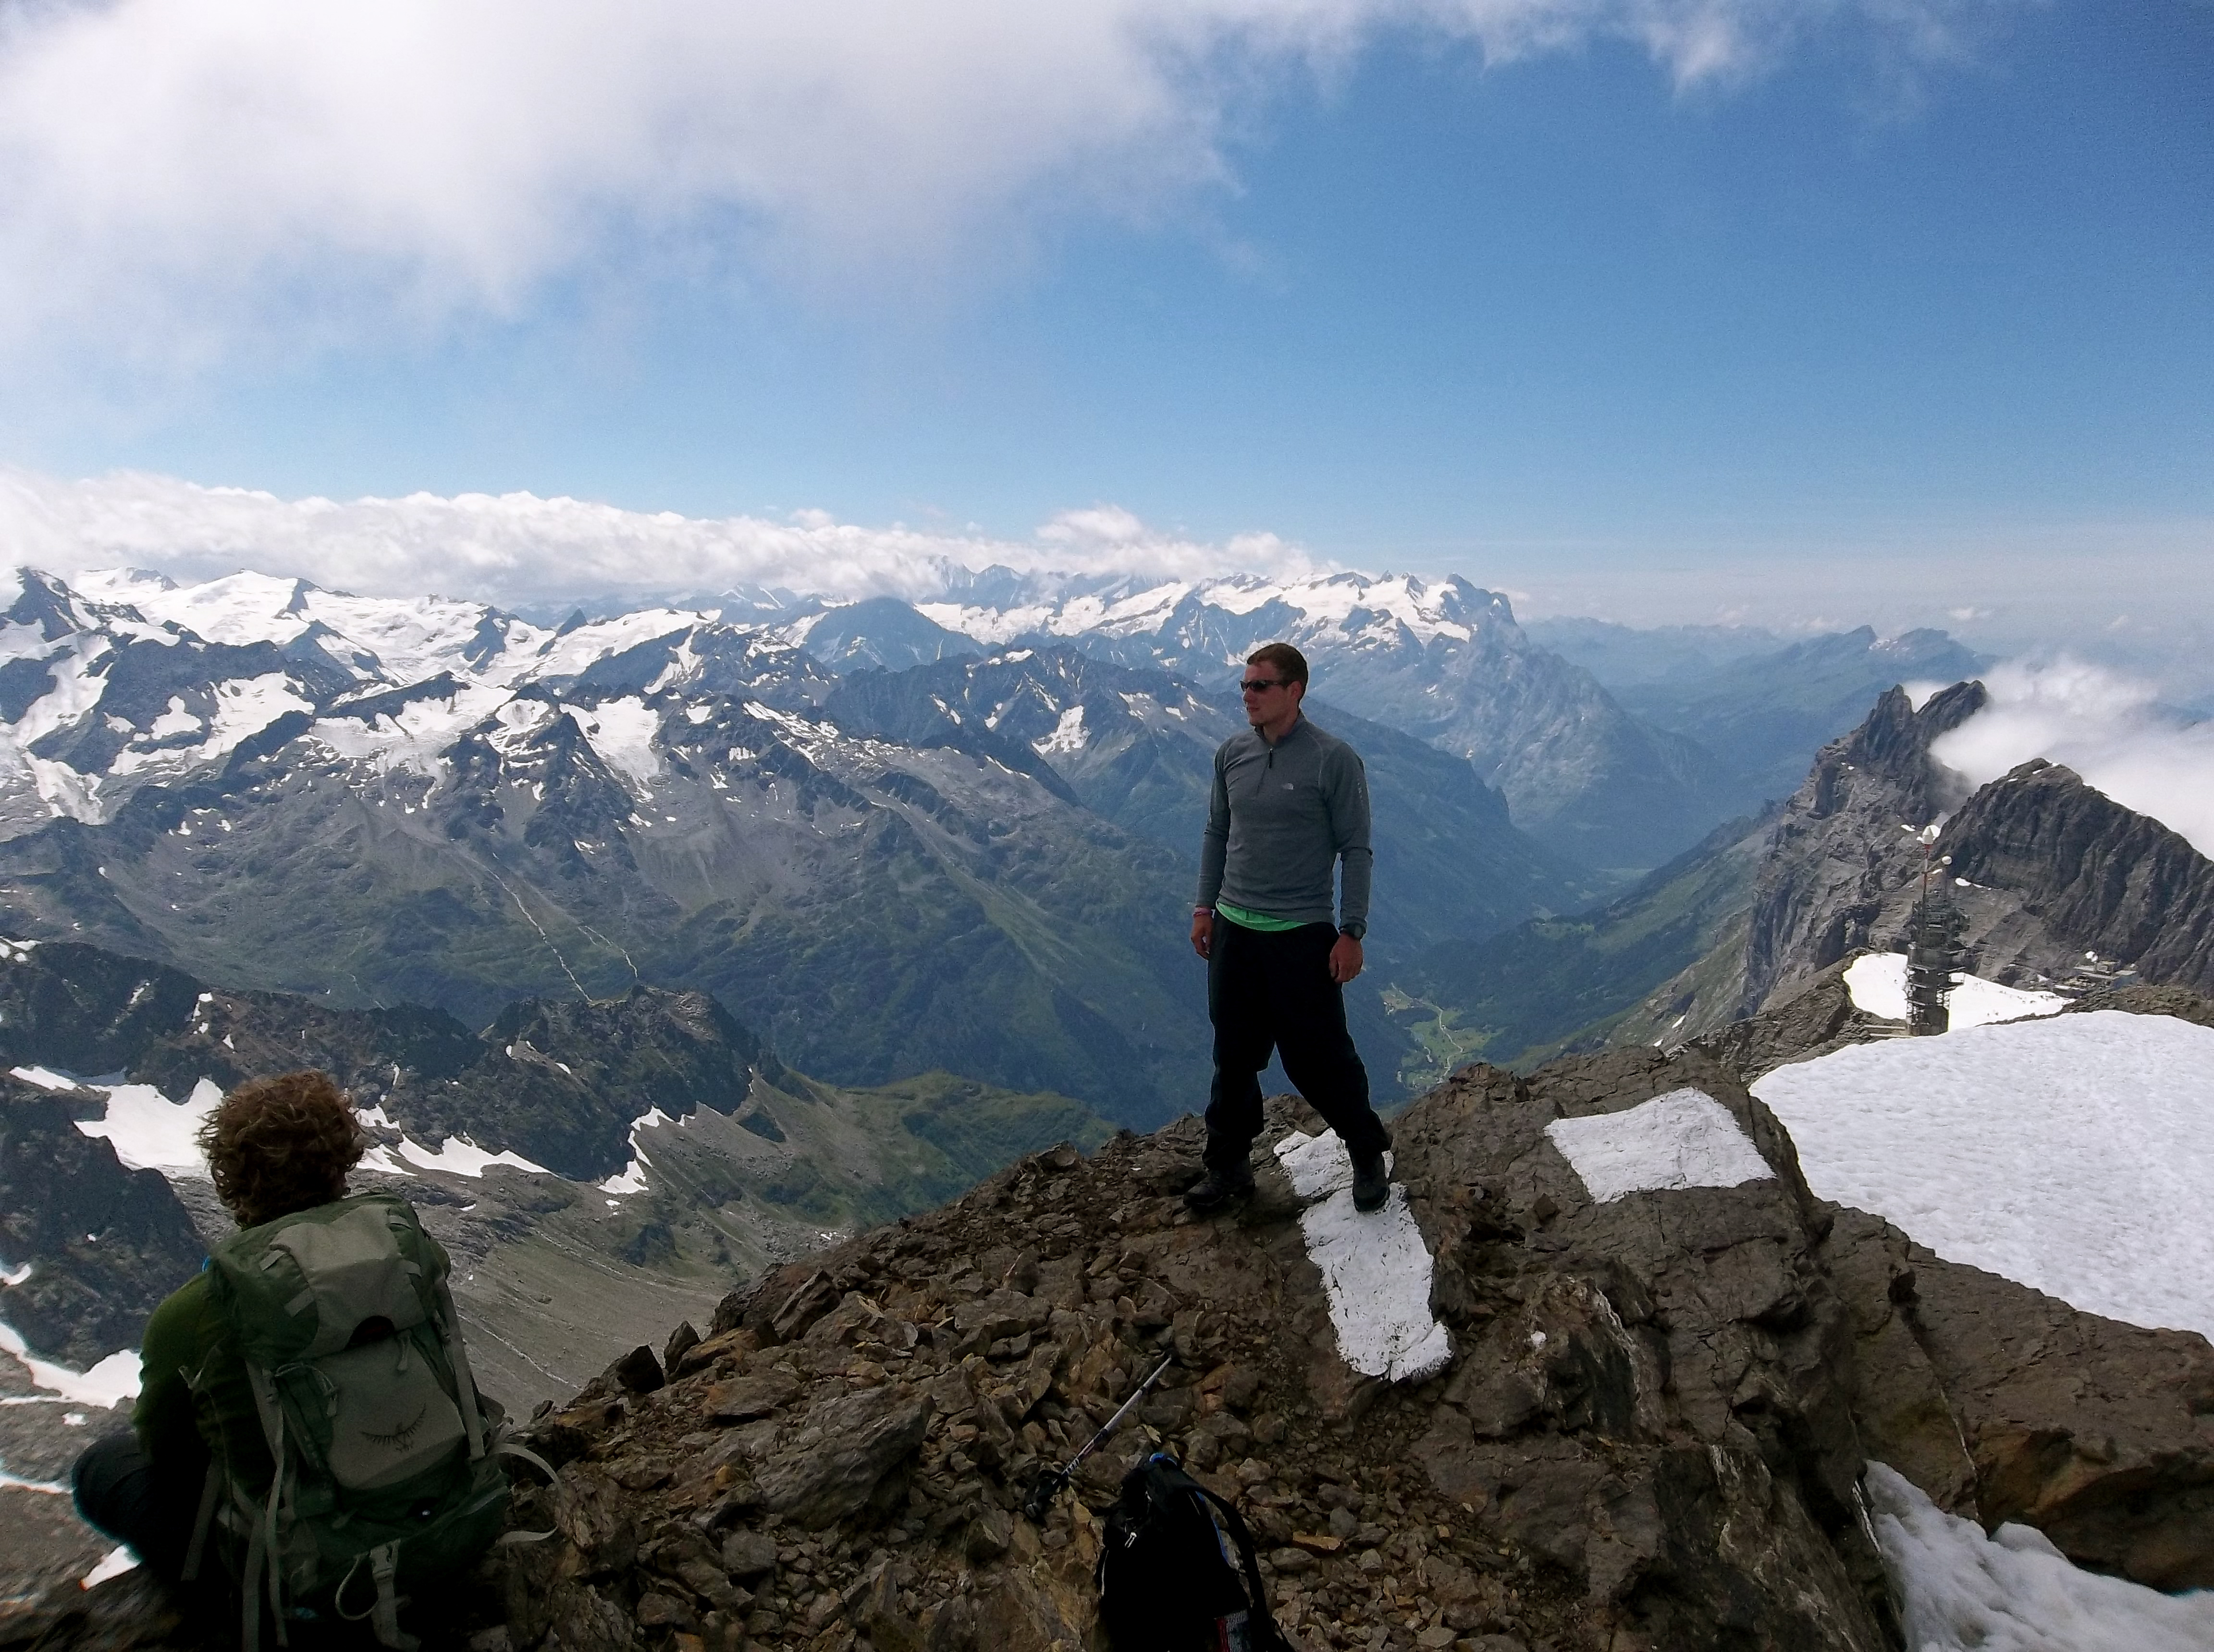
Travel Clinic Do not give medical advice
Encourage full disclosure
Australia, Canada, Japan, Mexico, New Zealand, or Western Europe:
Participants must disclose the following so the Travel Clinic can
assess the need of a clinic/physician visit:
  are not up-to-date on their routine immunizations;
  are on prescription medications; or
  have a pre-existing condition or chronic disease
Africa, Central/South America, Eastern Europe, Russia, or Southeast Asia
In addition to full disclosure, a clinical visit may be necessary due to health issues in-country:
  Participants should be referred to a certified travel professional.
  MSU Travel Clinic professionals are certified in travel medicine.
MSU student in Switzerland
OSA seeks to accommodate students with disabilities planning to study abroad

Slide 10
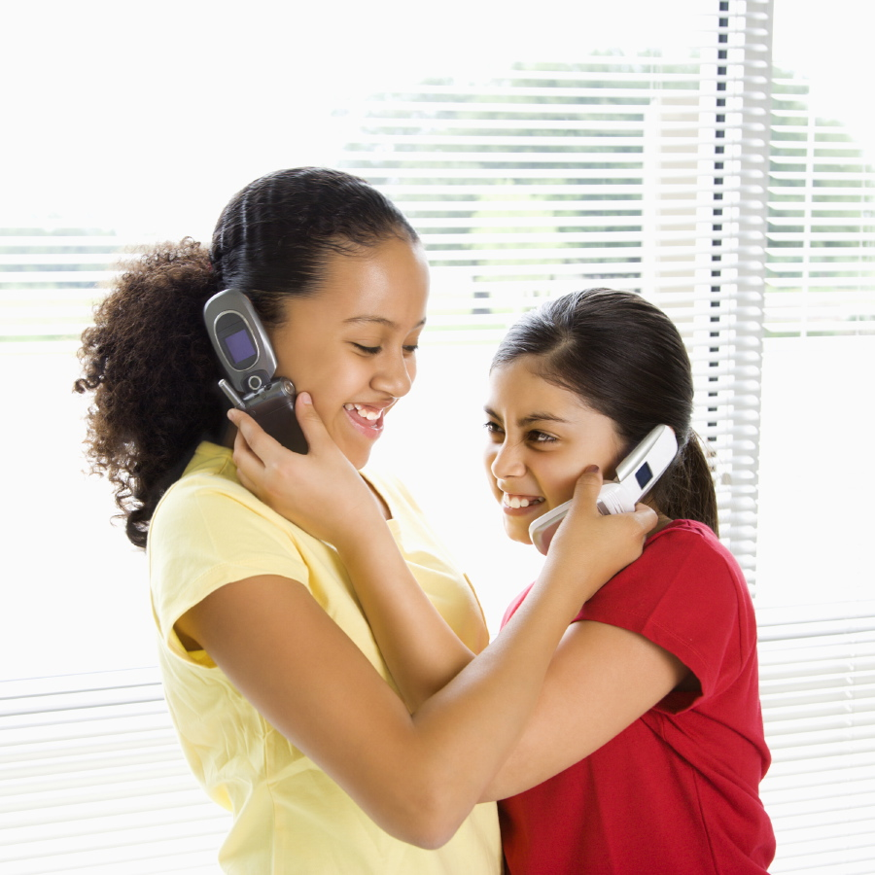
  Upon arrival Be prepared
  Test your cell phone*
  Report to OSA your local number
  Notify OSA immediately of no-shows
  Exchange phone numbers and local “911”** with your students and on-site colleagues
  Conduct an On-site Orientation
    Water and Fire Safety
    Emergency Action Plan
    Limit Setting
    Risk Mitigation
*http://www.howtocallabroad.com/
**http://studentsabroad…./911_ABROAD.pdf

Slide 11
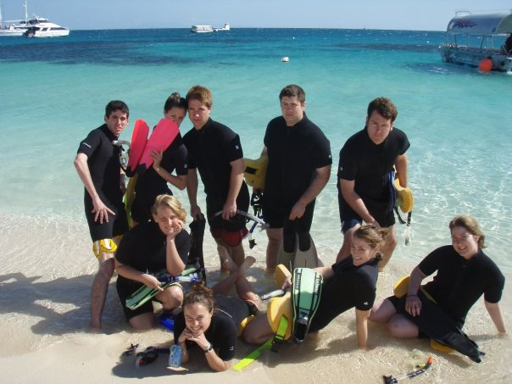
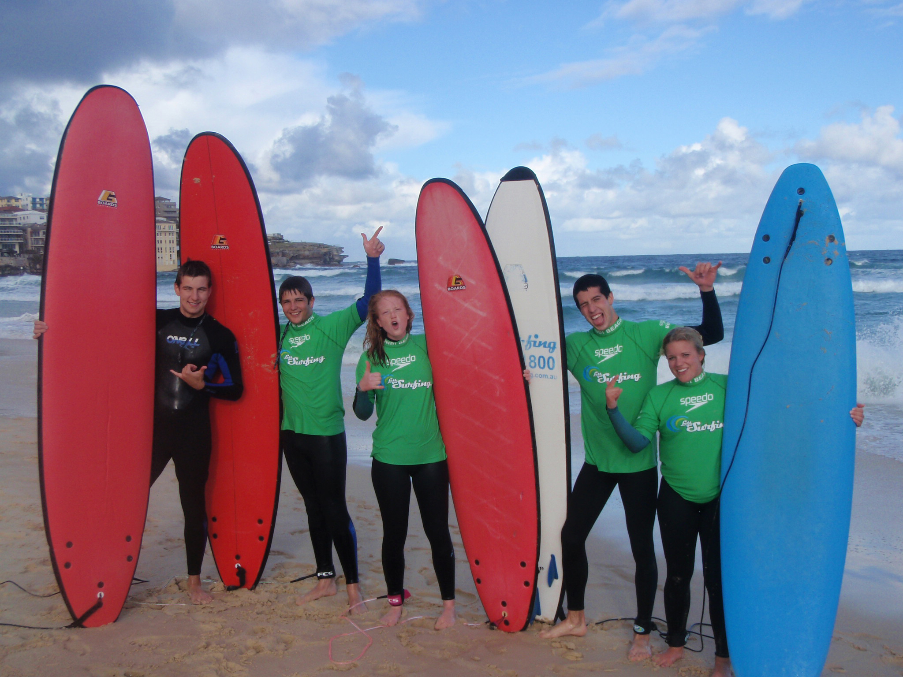
Water safety
If swimming is a part of your program:
  Be certain of students’ swimming abilities
  Be certain of the locations where you’ll be swimming
MSU students in Australia
If students intend to swim in their free time:
  Students can do whatever they want during their free time
  If there are locations you don’t recommend students go, say so – and in writing if necessary!
  If the students still go to these locations, at least they were informed
Students are generally naive about ocean currents,
rip tides, and undertows, so they are at greater risk.

Slide 12

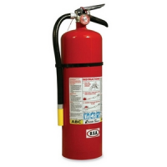


Fire Safety
Do you know the 911 # for Fire?
Do you have a smoke detector?
Do not live above the 7th floor.
Plan two ways out of every room.
Think about how you will escape the room in case of fire – do you have a ladder/a rope and window access?
Watch your smoking and cooking.
www.firesafetyfoundation.org
The day to day

Slide 13

Limit Setting Talk to the group
Students should perceive their group as their primary source of help and support.
Make it a place where...
They may explore their identity and safely express themselves
Group decision-making is emphasized and recognizes successful participation by others
Shape the environment by….
Use care and concern over coercion
Allow the group to address conflict first
Natural consequences can be the best teacher
Encourage Participation
Provide private time and space

Slide 14
Risk Mitigation It’s about perspective
“We have to recognize the risks to be able to mitigate them”
~ Ambassador Phillip Carter III AFRICOM
“The darkest thing about Africa has always been our ignorance of it.”
~George Kimble
Tips from a Program Leader /Researcher in Somalia
~Dr. Will Reno, Department of Political Science, Northwestern University
Don’t worry about identifying who the bad guys are. | Instead, ask yourself, “What are we being perceived as?”
Cultural miscues can be lethal. | Use “Productive Panic” as the cure for perceptual blindness.
When accepting the kindness of strangers … | “The guest is the hostage of the host.”
Safety plans, seminars, insurance and paperwork do mitigate risk so… | “Paper Up!”

Slide 15

Emergency Action Plan Plan ahead
Remind students to read the Safety and Travel section of the Student Guide
Remind students to review the Country Information from Travel.State.Gov
Discuss potential crises that could occur in your area
  Missing student; Terrorist Act; Active Shooter; Flood
Agree on when and how to check-in during an emergency
Designate a primary and a secondary meeting place
Discuss how you would report status to the OSA regularly
Remind students to check-in with family
Designate a student leader in case the program leader is incapacitated or unavailable
Identify an additional on-site contact person to OSA prior to departure if you are the ONLY program leader

Slide 16
Addressing Behavior Setting the stage
First Gen
Disruptions are normal - questioning of identity is to be expected.
~David Wick Ed.D SFSU 2013
African American
Asian
Hispanic
LGBTQ
STEM
White
American
Working Class
*Forming, Storming, Norming, Performing, Adjourning*
The stages of group development often occur during international programs and can be used to effect change.
~Jason Platt and Monique Jimenez The Forum 2013
The 2nd most important factor that leads to Intercultural Competence is facilitated learning before, during and after an intercultural experience. ~Janet Bennett, Ph.D. 2014
The number 1 factor is ………..

Slide 17

Addressing Behavior Relax
The number 1 factor that leads to Intercultural Competence is
Anxiety Reduction
~Janet Bennett, Ph.D. 2014
Mindfulness techniques
  Meditation
  Breathing
  Awareness
Guided imagery relaxation scripts
Turn off social media for an hour
Turn off the news and watch something else
Journal writing – Stream of consciousness writing
What else?

Slide 18
Addressing Behavior Respond
Identify the inappropriate behavior early
Set limits and expectations early
State the consequences clearly and carefully
Keep the Office of Study Abroad informed
All violations require due process - no three strikes rule.
Verbal notification to student and email to OSA
Written notification (in consultation with OSA)
Housing reassignment or dismissal (facilitated by OSA)
Egregious violations - Behavior that directly harms another person or property can result in dismissal Requires Director and General Counsel approval

Slide 19
MSU: 2000 Students Summer 2014
Snapshot of College Student Mental Health
ACHA (2012) in a randomized sample of 90,666 students
86.0% | - | Felt overwhelmed by all they had to do | 1720
50.7% | - | Felt overwhelming anxiety in the past year | 1014
31.3% | - | Felt so depressed it was difficult to function | 626
12.0% | - | Reported having an anxiety disorder | 240
11.0% | - | Reported having a depressive disorder | 220
7.1% | - | Seriously considered suicide in the past year | 142
5.5% | - | Had intentionally injured themselves | 110
1.2% | - | Actually attempted suicide | 24
50% have a disorder or are diagnosable
*The Forum Fireside Dialogue 2014

Slide 20
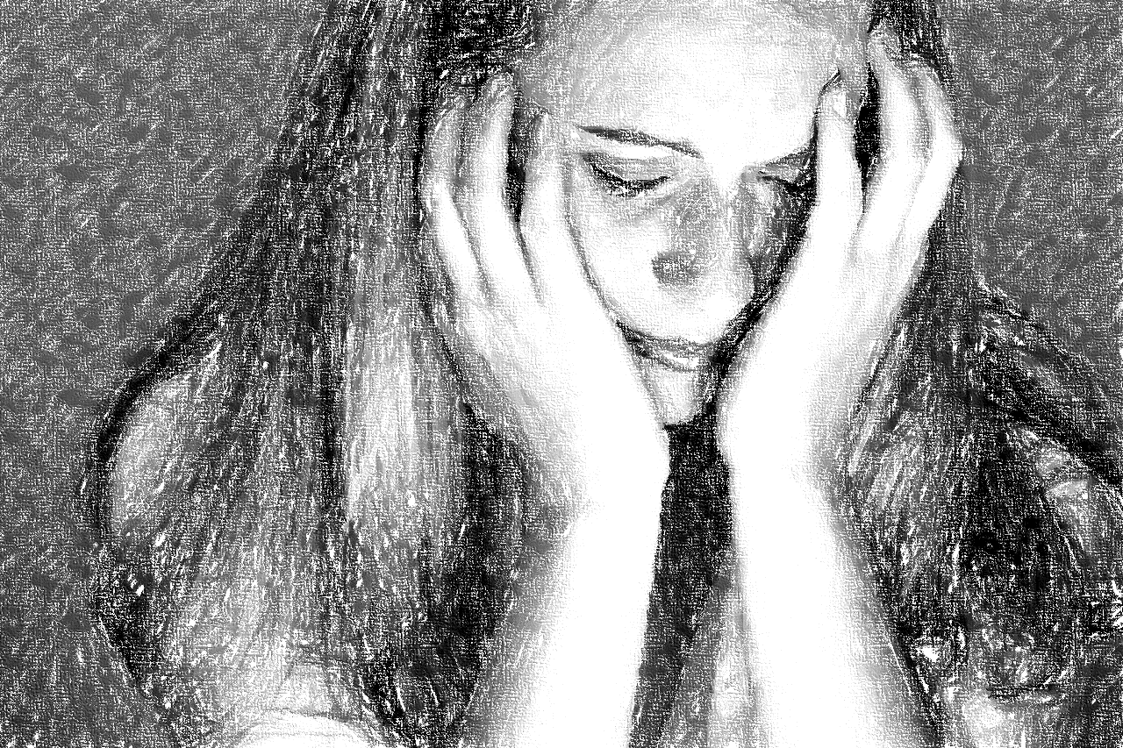
Observing Mental Health Issues
Comments on Mental Health Condition
Suicidal statements
Abrupt/radical changes in behavior
Isolation from others
Poor attendance in classes
Sudden outbursts of anger
Alcohol/drug abuse
Marked change in personal hygiene/appearance
Inappropriate crying
Bizarre statements/behavior
Don’t forget to take care of yourself!

Slide 21
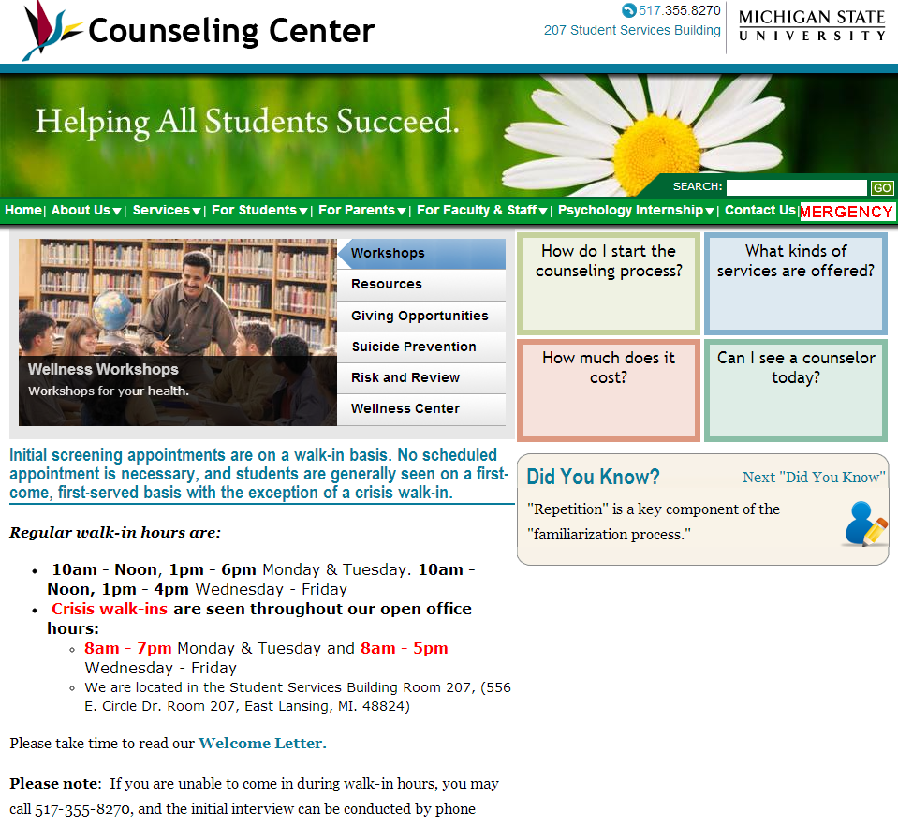
Addressing Mental Health Issues
Resist the urge to diagnose
Expect your students to face conflict as their identities are questioned.
Empathize more than you Question
  Reflect, Nod, Listen, silence, Uh-huh
5x2 Rule! Awkward Silence Counts!
In crisis use simple but direct questions. It is OK to ask about suicide!
Don’t try to “fix it”
If you have a student whose behavior leads you to believe they may have a mental health condition, Listen to your gut and call MSU’s 24/7 International Assistance Line +1-517-353-3784
Oh, and remember!
We are here for you, too!

Slide 22
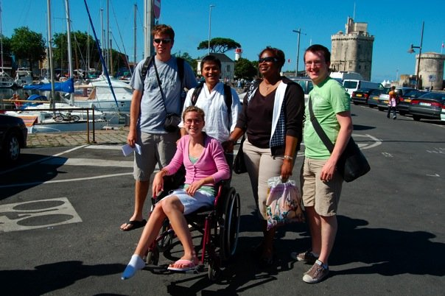
Incident Response Phone it in!
  PROFESSIONAL MEDICAL CARE IS REQUIRED
  Same-day Response Necessitates Phone Call
  Food poisoning, allergic reactions, Injuries
  Anything of a mental health nature
  Crime and Behavioral Incidents
  Disruptive behavior, alcohol, drugs
  Rape or sexual assault
  Arrest or incarceration
  Natural disasters
  Earthquakes
  Floods or volcanoes
  Civil unrest
  Riots or demonstrations
  Terrorist attacks or acts of war
  Anything “newsworthy” regardless of its impact on students or programs
  Even if the incident has passed and all is well

Slide 23





Applicable Laws Keep in mind
  FERPA/HIPAA
  Phone calls are best, limit email content
  Restrict parental contact
  Title IX Sex Discrimination, Harassment & Bias Incidents
  Immediate reporting
  Office of Inclusion
  Title II of the ADA
  Prohibits discrimination against people with disabilities
  Significant risk to the health or safety of self or others (March 15, 2011)
  The Clery Act
  Campus crime reporting
  Office of General Counsel
  MSU Employment Policies
  Faculty Handbook
  Anti-Discrimination and Sexual Harassment

Slide 24
Incident Response Incidents & Resources
Student/
Leader
Incidents
Resources
HEALTH
911*
HTH
University Physician
Call 24/7 Int. Line
+1-517-353-3784
General Counsel
LEGAL
HTH Insurance
CRIME
DPPS
CADET
FrontierMEDEX
NATURAL DISASTER
DPPS/FBI
CIVIL UNREST
On-Call Responder
U.S. Embassy
Office of Risk Mgmt

Slide 25


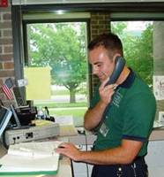
Incident Response For Everyone!
Risk to Life, Limb or Eye - Call an ambulance immediately!*
Health Incident – Call HTH Worldwide before you see a doctor!
Always call MSU through the 24/7 number to activate same-day internal response protocols: +1**-517-353-3784 (Can also call collect)
*http://studentsabroad.state.gov/content/pdfs/911_ABROAD.pdf
**http://www.howtocallabroad.com/
Notes:
You know this stuff….

Slide 26

Thank You!
Ben Chamberlain
International Health & Safety Analyst
Office: 517-432-8686
Email: chambe84@msu.edu
Twitter: @chambe84
Skype: ben.chamberlain.msu

